Slide 1
CHARACTERS OF The Crucible

Slide 2
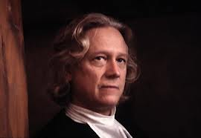
REVERAND SAMUEL PARRIS
Religious, powerful, political leader of Salem, greedy, self-centered

Slide 3
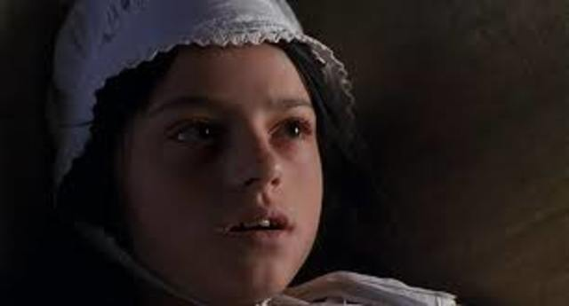
Betty parris
Daughter of Reverend Parris, ill in bed, caught dancing

Slide 4
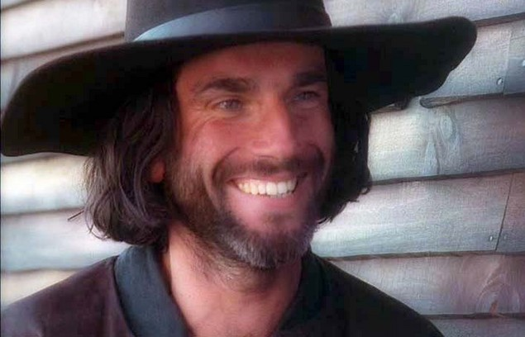
John Proctor
Farmer, voice of reason, does not go to church regularly, had an affair with Abigail.

Slide 5
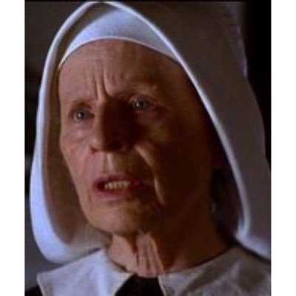
Rebecca Nurse
Reasonable, wise old woman, very healthy, many children (11 children and 26 grandchildren), none died

Slide 6
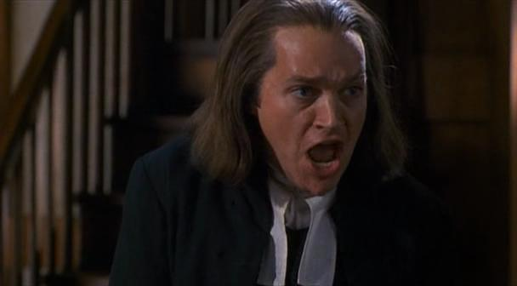
Reverend john hale
Witch/Devil expert brought into Salem

Slide 7
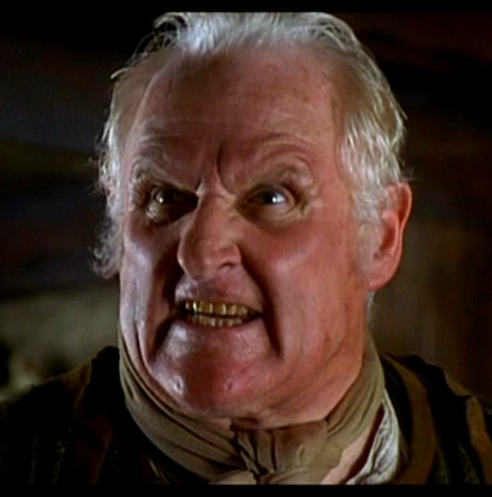
Giles corey
83 years old, sues everyone to get more land

Slide 8
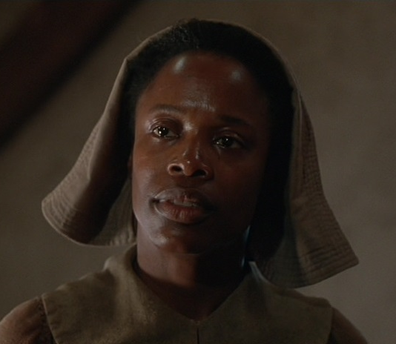
Tituba
Parris's slave, practices voodooism, from Barbados

Slide 9
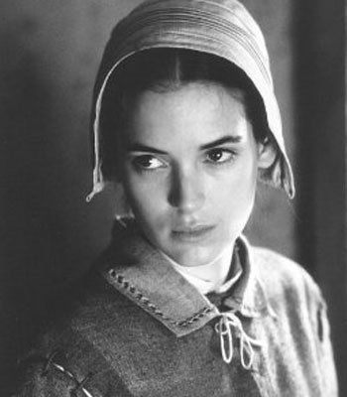
Abigail williams
Parris's 17 year old niece, Betty's cousin, leader of the girls, caught dancing

Slide 10
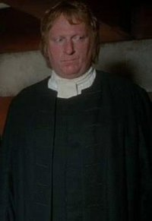
Thomas Putnam
Very prominent landowner, holds a grudge against everyone in town

Slide 11
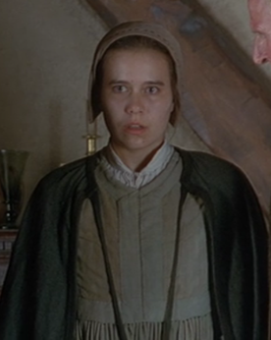
Mary warren
Proctors servant, friend of Abigail, caught dancing

Slide 12
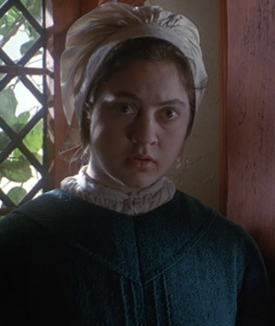
Mercy lewis
Putnam's servant, friend of Abigail, danced in the woods

Slide 13
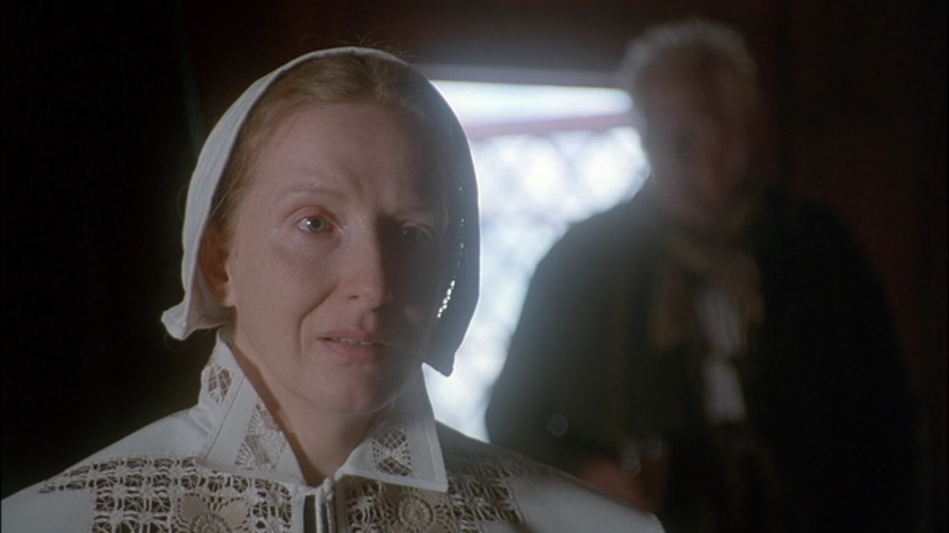
Ann putnam
Mother of Ruth, buried 7 of her 8 babies

Slide 14
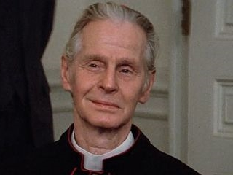
Francis Nurse
Rebecca’s husband, well regarded in town, is against Parris

Slide 15
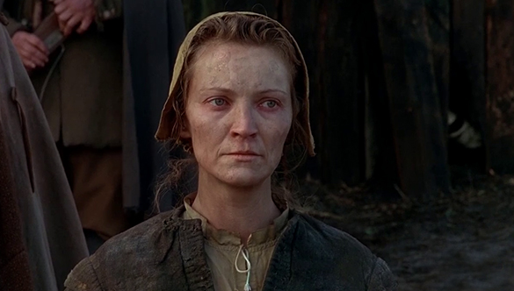
Elizabeth Proctor
Very honest, Married to John Proctor, Has not been to church since firing Abigail

Slide 16
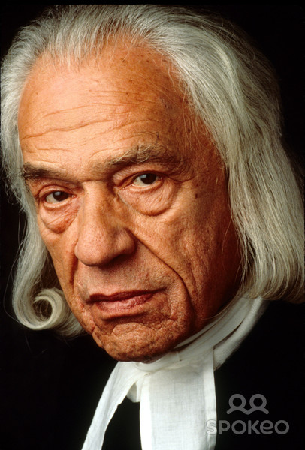
Judge hawthorne
Presides over trials, bitter, remorseless

Slide 17
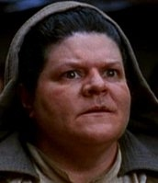
Martha corey
Married to Giles Corey, reads strange books

