Slide 1
Franklin Sousley
Eva, Alexis, Salvador, Celeste, Ruby

Slide 2
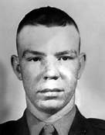
When and where was he born?
He was born in Kentucky and in 1809

Slide 3
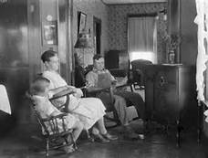
Who were his family?
His Mom was Goldie
His dad was George
And his son was Malcolm

Slide 4
How was their personality?
Franklin had a good and humorous personality he was able to make people smile.
Goldie would have a strong connection with franklin

Slide 5
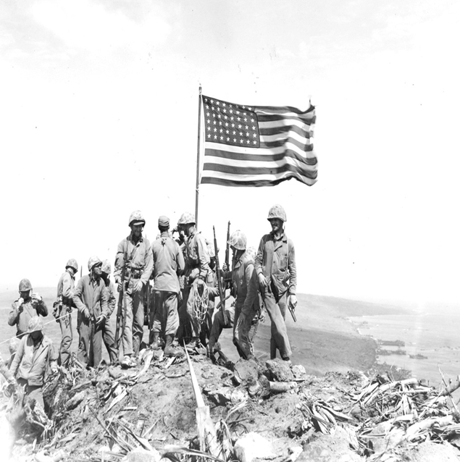
How did they come to join the military?
They wanted to help find a way to pay off his mothers deep finances
Wanted to help out after hearing out what happen

Slide 6
Other information
He wanted to pay off his moms dept.
Was an average student
He was liked
WWII hovered in for distance to back ground of his boy hood

