Slide 1
American (Gothic) Romanticism
Lopez/Oakley
English 5-6

Slide 2
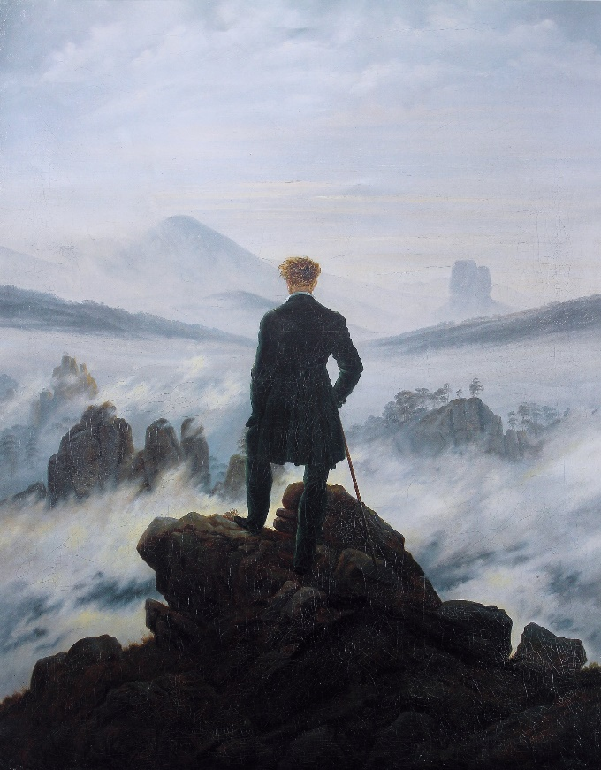
American Romanticism 1800-1860
Was “a journey away from the corruption of civilization and the limits of rational thought and toward the integrity of nature and the freedom of the imagination.“
History
Began in Germany in the late 1700’s
Was a reaction against rationalism – which tried to reason away the problems of society
All People read before this was stories from or inspired by the Bible

Slide 3
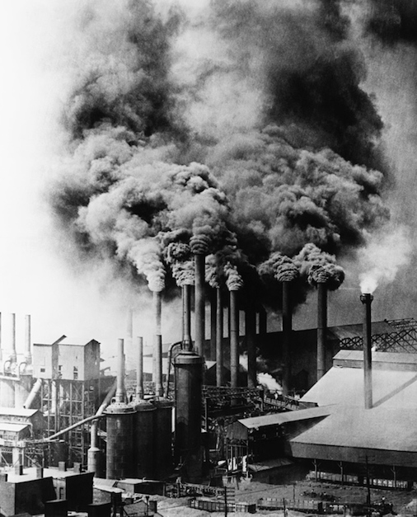
American society during romanticism
Life in the city during the Industrial Boom:
In permanent tenements, buildings might house four hundred families
City streets were littered with horse droppings--even with the carcasses of deceased animals
Disease was so common place, in 1832, a cholera epidemic killed as many as 100 people per day in Manhattan
There were 20,000 homeless children on the streets of New York, most of whom died before they were twenty
Crime and violence were a part of life
People wanted to escape
the harsh realities of life

Slide 4
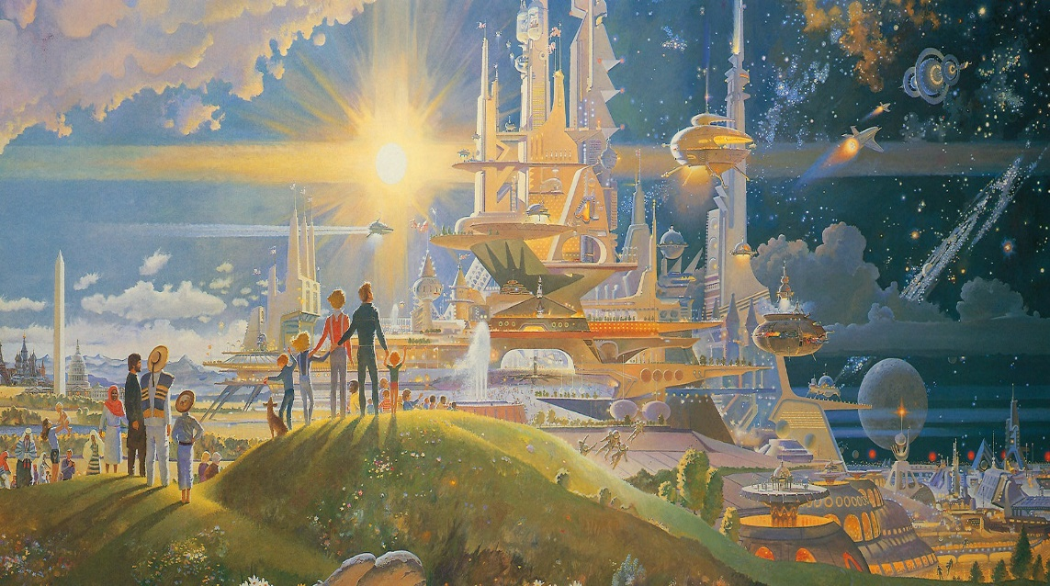
"Suspension of Disbelief“
American Artists, Writers & Philosophers rebelled - Wanted to deal with EMOTIONS
Romantics wanted to find a higher truth, or meaning in life above the "dull realities" by APPEALING TO THE IMAGINATION
Create a world where ANYTHING IS POSSIBLE – also called
“Romantic Escapism”
Find exotic settings - sometimes a supernatural realm like
Nirvana, Utopia, or Atlantis

Slide 5
Romanticism/American Gothic (1800-1855)
Based on concept of
MACABRE
Focuses on the DARK SIDE of the Imagination
MACABRE is literature that dwells on DEATH
Gothic literature (Macabre) all have elements of:
Supernatural
Darkness
Horror
Victimization
Torture
Murder
Death
Suicide
Ghosts/Demons
Gloomy Settings

Slide 6
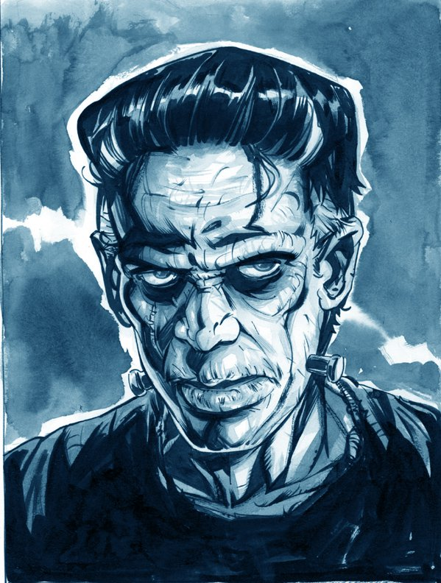
Artists of American Gothic
Mary Shelley
Frankestein
Washington Irving
The Legend of Sleepy Hollow

Slide 7
Stock (typical) characters in gothic literature
The characters include:
Tyrants
Villains
Bandits
Maniacs
Byronic Heroes
Persecuted Maidens
Femmes Fatales
Monks
Aliens
Nuns
Madwomen
Magicians
Vampires
Werewolves, Monsters
Demons
Dragons
Angels
Revenants
Ghosts
And The Devil Himself.

Slide 8
Quick Assignment
Watch the next (2) Two Movie Clips
Write down at least 3 examples of Gothic Romanticism within the clips (1 for each)
How does each show the characteristics of the concept of MACABRE?

Slide 9
SIGNS

Slide 10
THE HAPPENING

Slide 11
SIGNS

Slide 12
Gothic Setting
Importance of Setting
Atmosphere of horror and dread
Deterioration of the world
The decaying, ruined scenery implies that at one time there was a thriving world.
Place and time that invites curiosity and uncertainty
" It was a Dark and Stormy night“
An old barn with squeaky hinges on the door
A small town with a spooky past.

Slide 13
Details
Authors of suspenseful literature will focus on the small details such as:
- knock on the door
- turn of a key
- shadow moving in the corner

Slide 14
Features of Gothic Literature
Action occurs or takes place at night - or at least in a claustrophobic, sunless environment.
Ascent - up a mountain high or staircase
Descent - into a dungeon, cave, underground chambers or labyrinth) or falling off a precipice; secret passage; hidden doors;
The Pursued Maiden (Abduction) - Physical Decay, Skulls, Cemeteries, And Other Images Of Death; Ghosts; Revenge; Family Curse; Blood And Gore; Torture; The Doppelganger (Evil Twin Or Double); Demonic Possession; Masking/Shape-changing; Black Magic; Madness; Incest.

Slide 15
The Grotesque
A mix of two separate modes, such as comedy and tragedy, creating a disturbing fiction, in which comic circumstances often preclude horrific tragedy and vice-versa.
Primarily concerned about the distortion and transgression of boundaries, be they physical boundaries between two objects, or psychological boundaries, or anything in-between.

Slide 16
The Grotesque
There are TWO MAIN WAYS to define something as Grotesque:
1. Fits in between the real and the fantastic (non-real)
2. Simultaneously fits somewhere between being funny and being frightening.
(A bit more difficult to gauge, as what is funny to one person is frightening to another)

Slide 17
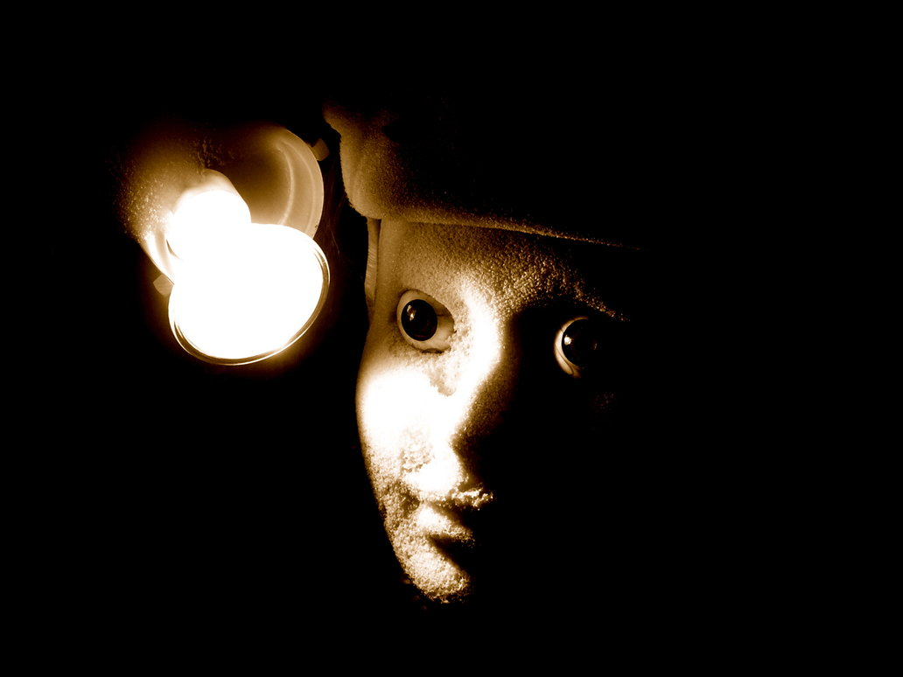
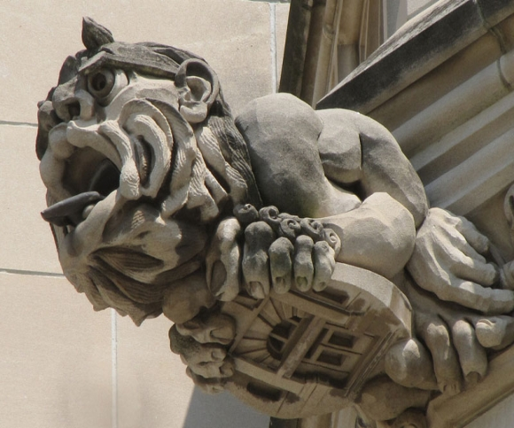
The Grotesque appears in all mediums

Slide 18
Edgar Allen Poe
1809-1849
Master of Gothic horror
Orphaned by age 3, taken in by wealthy John Allen, but kicked out by age 18
Excessive gambling, strange behavior
Married young cousin Virginia Clemm in 1836
She was 13 years old at the time
She died 11 years later, he died 2 years after at age 40

