Slide 1
Harlon Block
Kelly Gonzalez
Caleb Barnett
Jennifer Fraga
Adriana Celeya
Pedro Flores

Slide 2
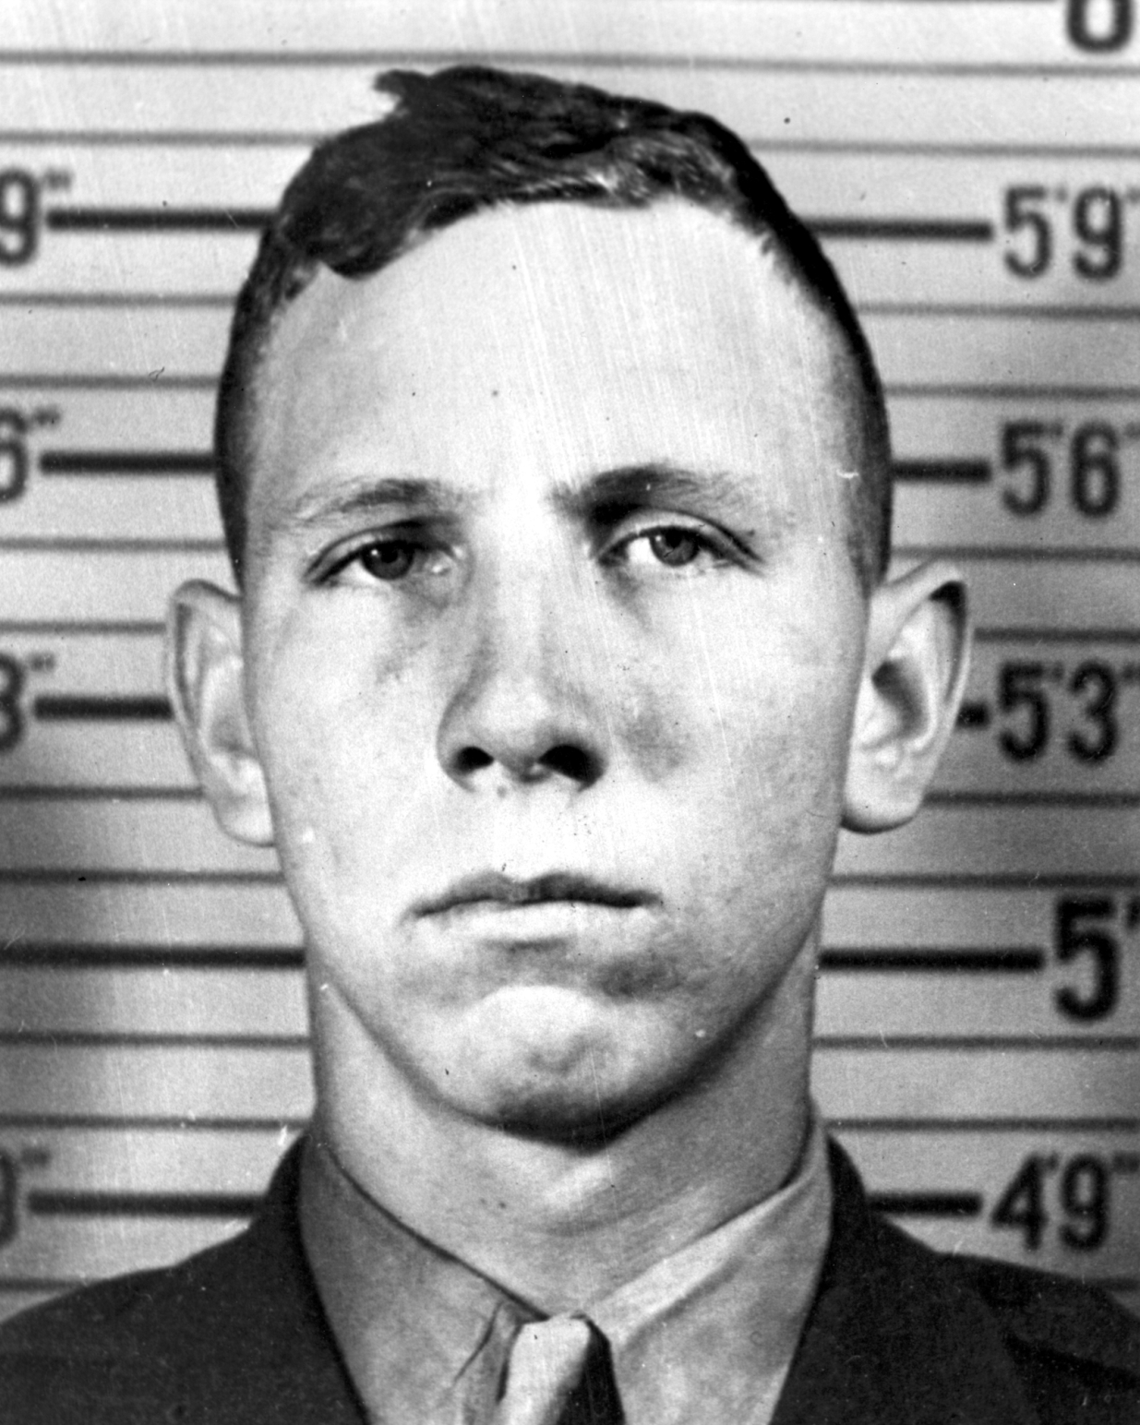

Slide 3
Questions
Where were they born?
On a farm in Rio Grande Valley, Texas in 1924
Where did he grow up?
On a farm in Valley Texas
Who’s his family?
Parents: Ada Belle Brantley & Ed Block
Siblings: Ed Jr., Maurine, Larry, Corky, Melford
What was his childhood like?
During Harlon’s childhood, he was surrounded by flat, lush land dominated by small farms, large cultivated fields and the occasional town of 1,000 to 2,000 people.
He was mainly doing chores around the farm.

Slide 4
Questions
How was his personality? How did people see him?
Harlon was a good helper, he always completed his chores without complaint, he took orders well and he fit in as part of the family. Other people saw him as a hard working man.
How did he come to join the military?
Harlon was a hell raiser so they thought he would be perfect for the military as a symbol to the world of a male bravado.

