Slide 1
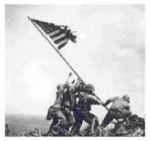
Ira Hayes
Alexis Barraza, Ahtziri Ortiz, Adrian Robles, Victoria Howard, Victor Santos

Slide 2
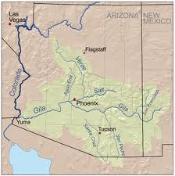
Where/when was he born?
Ira Hayes was born and raised in Gila River Arizona, on January 12, 1923.

Slide 3
Where did he grow up?
Ira grew up on Gila River Arizona.

Slide 4
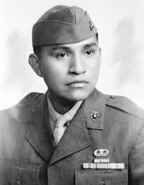
Who is his family?
Nancy and Jobe were his parents.
Ira Hayes was the oldest of 6 children.
4 of his siblings died before the age of 30.
Kenny Hayes was the only one left when James Bradley interviewed him. He was 67 at the moment.

Slide 5
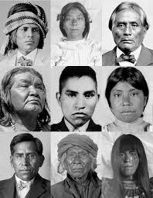
What was their childhood like?
Ira was separated from other Americans since the day he was born because he was an Indian/Pima.
Pima’s weren’t able to vote or sue anyone in courts.
Their childhood home was born into one-room adobe hut built of mesquite posts and arrowhead rock.

Slide 6
How was his personality? How did other people see him?
Hayes was known as a quiet person just like his father.
His favorite game was solitaire.
People saw him as a quiet man.
He was always separated from hiss other friends.
He would go days without talking to anyone, he would only talk if you spoke to him first.

Slide 7
How did he join the military?
Ira enlisted 9 months after Pearl Harbor.
He was 19 when he enlisted.

Slide 8
Other information?
Not a lot of people knew about him.
He was one of the three who survived.
He died of the age of 32, he was drunk and fell outside and died of exposure.

