Slide 1
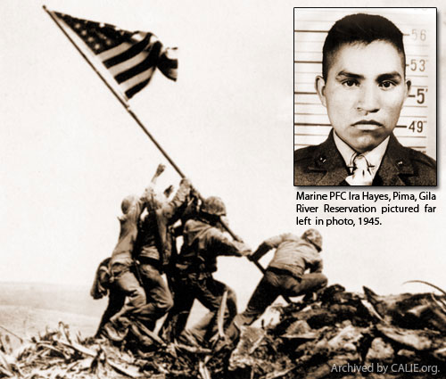
Ira Hayes
Shawn Phinsavanh,
Alejandro Guerrero,
Joel Bennett,
Erika Sorto,

Slide 2
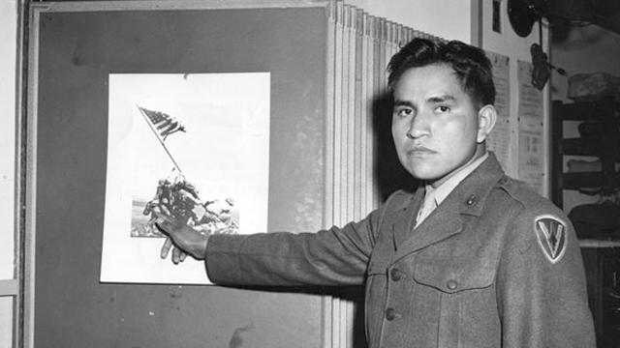
LIFE BEFORE WAR
Born January 12, 1923 on the Gila River Indian reservation , where he grew up.
His family included Jobe, Kenny and Nacy Hayes. One important person was Dana Norris.
His childhood was consisted of education and books.
His personality was quiet and shy, that how people saw him.
He wanted to join the military because many others joined after Pearl Habor.
An American Legion post is named after him, that’s about one mile away from his house.

