Slide 1
PARTS OF SPEECH
REVIEW
Lopez/Oakley

Slide 2
WARM-UP
A word that expresses action or state of being.
A word that describes a verb, an adjective, or an adverb (Hint: Often ends in –ly)
A word used in place of a noun.
A word that describes a noun or a pronoun.
A word that shows direction, location, or time, or introduces an object. They are usually followed by an object
A word that names a person, place, a thing, or an idea.
Noun
Pronoun
Verb
Adjective
Adverb
Preposition

Slide 3
WARM-UP ANSWERS
C - Verb
E - Adverb
B - Pronoun
D - Adjective
F – Preposition
A - Noun

Slide 4

NOUNS
A noun is a word used to name a:
  Person , Place , Thing , Abstract idea
  EX:
    The car was stolen from the parking lot.
    Ms. Oakley is a great teacher.

Slide 5
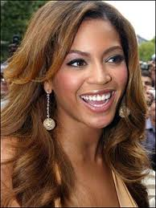
PRONOUNS
PRONOUNS are words that replace nouns in a sentence
  Examples
    I, you, he, this
    who, what
Pronouns basically replace nouns so as not to repeat them over, and over, and over again!!!
Beyonce is pretty.
She is also talented.

Slide 6
VERBS
VERBS – express actions, events, or states of being of a noun or pronoun
  Examples:
    She took a bite of the apple.
    John and Frank fought over the paper.
    I could smell the turkey from here.

Slide 7


ADJECTIVES
ADJECTIVE – describes, identifies, or quantifies nouns or pronouns
  Examples:
    The green frog was eating.
    A new quarter is worth more than it seems.

Slide 8



adverbs
ADVERBS – are words that modify verbs, or make them clear
  CLUE: Usually end with –ly but not always
  EXAMPLES:
    He ran quickly.
    She waited patiently.
    They loudly screamed in the library.

Slide 9
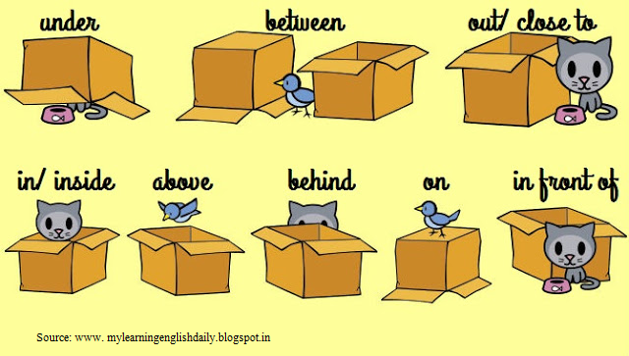
PREPOSITION
PREPOSITION – A word that shows direction, location, or time, or introduces an object.
CLUE: In the word it says prePOSITION
  EXAMPLES:
    We walked up the stairs.
    I leaned against the wall.

Slide 10
Game time
Write down which Part of Speech each of the underlined words in the sentences are.

Slide 11
They attended the concert last weekend.
Several cats ran into Rob’s garage.
The truck driver delivered the packages quickly.
Fast runners won all the awards at the track meet.
My friends and I walked home after school.
I’ll arrive sometime between 5pm and 6pm.
I wanted a peanut butter and jelly sandwich for lunch yesterday.
She was counting the ballots during social studies class.
Hey! That is my seat.
Will they finish the test on time?
The diagram was pretty complicated for us.
Did you watch football on TV last night?

Slide 12
Attended - VERB
Garage - NOUN
Quickly - ADVERB
Fast - ADJECTIVE
Walked - VERB
Between - PREPOSITION
I - PRONOUN
Counting - VERB
Seat - NOUN
They - PRONOUN
Pretty – ADVERB
On - PREPOSITION

