Slide 1
Rene Gagnon

Slide 2
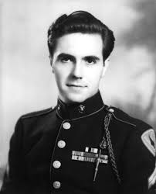
Where/ when were they born?
Rene was born in Manchester.

Slide 3
Where did they grow up?
Rene arrived to the French Canadian Mill on March 7, 1925.
Rene grew up on the West side of Manchester, New Hampshire.
( French was the language and Catholicism was the religion.)

Slide 4
Who is their family? Other important people?
Rene’s parents were Irene and Henry Gagnon.
Rene grew up alongside with his mother.
Henry cheated on Irene, she later divorced him and never allowed him back to the house.

Slide 5
How was their personality like? How did other people see them?
Rene was a handsome young man.
He had a lean gallic face, dark hair and eyebrows.
Rene was a shy person, didn’t speak much.
He was unaggresive, a quiet boy.

Slide 6
What was their childhood like?
Rene’s childhood was tranquil, he spent most of his time with his mother.
Never knew of his dad ever again until after the war.
Spent no time on his own.
He was an only child.

Slide 7
How did they come to join the millitarty.
Rene heard of this on the Halson radio,he later listened to the news and read about it.
Rene kept on working right up until his Army draft notice arrived in May of 1943.
He enlisted in the Marines and at the age of 17 he went into war.

Slide 8
Other information
Rene was a Doffer in the French Canadian Mills.
After 2 years of High School he dropped out.
Only the tip of his helmet and his 2 hands were visible in the picture.

