Slide 1
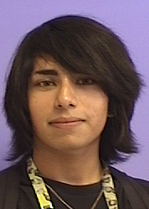
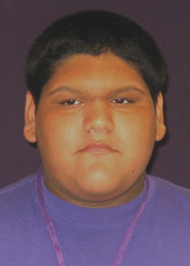
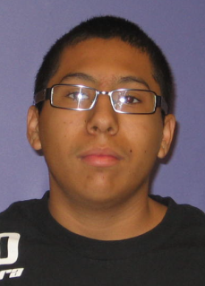
Rene Gagnon
By Craig Valentine Nick Pope,Jose Sisneros and Daniel George

Slide 2
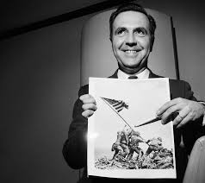
Rene Gagnon
Born on March 7 , 1925
Grew up in New Hampshire, Manchester
Raised with no father mother was his only family
childhood was influenced by mother little friends and worked at the mill
Rene Gagnon was shy with a timid personality
Rene Gagnon was enlisted in the army at 16 by the draft

