Slide 1
RHETORIC & REBELLION
Lopez
English 5-6

Slide 2
Aristotle
Written in the 4th century B.C.E., the Greek philosopher Aristotle compiled his thoughts on the art of rhetoric into On Rhetoric
Rhetoric - the study of writing or speaking as a means of communication or persuasion

Slide 3
RHETORIC
including his theory on the three persuasive appeals.
Ethos – Speaker Credibility/Values & Moral Standards
Pathos – Emotional Connection
Logos – Logical Argument

Slide 4
ETHos Credibility/Ethics
Ethos is an appeal to ethics, in other words convincing the audience the author/character, etc. is a credible (believable) person.
You can convince an audience to accept anything you say, they have to accept what is being said as credible.
There are many aspects to building your credibility:
Does the audience respect the author/character, etc.?
Does the audience believe the author/character, etc. is of good character?
Does the audience believe the author/character, etc. is generally trustworthy?
Does the audience believe the author/character, etc. is an authority on this speech topic?

Slide 5
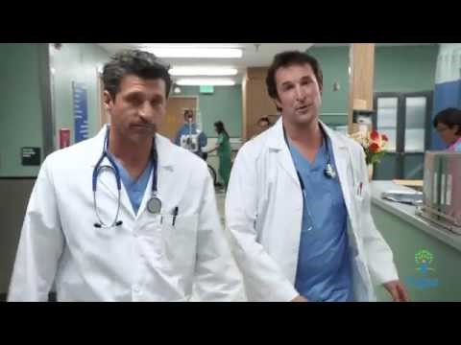
ETHOS Example

Slide 6
LOGOS Facts & Logic
Logical appeals rely on logic & facts to support a claim.
Logos is synonymous with a logical argument.
Does your message make sense?
Is your message based on facts, statistics, and evidence?
Will your call-to-action lead to the desired outcome that you promise?

Slide 7
LOGOS EXAMPLE

Slide 8
PAtHOS Emotions/Feelings
Emotional appeals present ideas and images that elicit strong feelings.
Pathos is the quality of a persuasive presentation which appeals to the emotions of the audience.
Do your words evoke feelings of … love? … sympathy? … fear?
Do your visuals evoke feelings of compassion? … envy?
Does your characterization of the competition evoke feelings of hate? contempt?

Slide 9
PATHOS EXAMPLE

Slide 10
MORE Rhetorical devices
Rhetorical Question – question that does not require a reply
EX: “Seriously? Do we have to go through this again?”
Antithesis – a device in which contrasting ideas are expressed
EX: “…you’re not special. Because everyone is.”
Repetition – use of the same word or phrase for emphasis
EX: “I have a dream that my four little children will one day live in a nation where they will not be judged by the color of their skin but by the content of their character. I have a dream today.”

Slide 11
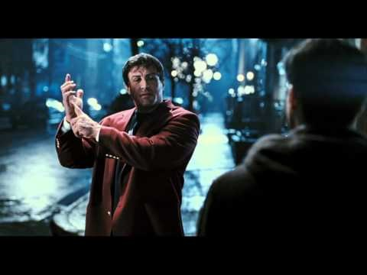
ROCKY BALBOA SPEECH

Slide 12
Annotate the speech
Mark the speech for the 3 types of persuasion
CIRCLE the ETHOS
SQUARE the PATHOS
UNDERLINE the LOGOS

